Slide 1


Carbon Sense

Slide 2
Problem Statement
With growing concerns about climate change and environmental sustainability, individuals are increasingly looking for ways to reduce their carbon footprint. However, many people struggle to understand the specific impact of their daily activities, such as energy use, transportation choices, and waste production. For example, someone might be unaware of how their energy consumption at home contributes to their overall carbon footprint or how their transportation choices affect the environment. Existing resources often provide generic advice but lack personalized insights that resonate with users' individual lifestyles and habits.

Slide 3
Introduction
Welcome to the world of Carbon Sense, where we delve into the fascinating topic of carbon emissions and their impact on our planet. In this document, we will explore the causes and consequences of excessive carbon emissions, as well as discuss potential solutions to mitigate their effects. Whether you are a concerned individual or a policy maker, this document aims to provide you with valuable insights and knowledge to foster a more sustainable future for all. So, let's embark on this journey together and deepen our understanding of carbon sense!

Slide 4
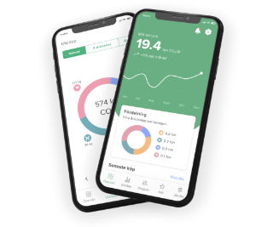
Vision and Mission
1
User Management
2
Carbon Emissions Tracking
The system must allow users to register, log in, and manage their profiles.
The system must allow users to input data related to their activities (e.g., electricity usage, travel, etc.) and calculate the corresponding carbon emissions.
3
Monthly Emissions History
4
Data Visualization & Reporting
The system must store and display a history of the user's carbon emissions on a monthly basis.
The system should provide visual representations of the user's emissions data over time and allow users to generate reports of their carbon emissions.

Slide 5


Non-Functional Requirements
Performance
The system should calculate and display carbon emissions data with minimal latency
Scalability
The architecture should support increased load as more users begin tracking their emissions.
Security
Data must be encrypted in transit and at rest. Use JWT for authentication and authorization.
Availability & Maintainability
The system should have an uptime of 99.9%, with failover mechanisms in place. Code should follow SOLID principles, with high modularity and low coupling.

Slide 6
Technologies Used
Backend
Frontend
Other
Programming Language: Java 17 for backend services.
Angular for building the user interface.
Containerization: Docker for containerizing services.
Frameworks: Spring Boot for building microservices, Spring Security for authentication and authorization.
Database: MongoDB for storing persistent data.
API Communication: RESTful APIs using Spring Web.

Slide 7
High-Level Design: Architectural Overview
API Gateway
1
Acts as a single entry point for all client requests, routing them to the appropriate microservice.
2
User Service
Handles user-related operations such as registration, login, and profile management.
Carbon Emissions Service
3
Manages the tracking of user activities and the calculation of carbon emissions.
4
History Service
Stores and retrieves historical carbon emissions data for each user.
Reporting Service
5
Generates reports and visualizations based on user emissions data.

Slide 8



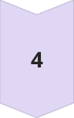


High-Level Design:
User Logs In
The user logs in and views their dashboard.
User Enters Activity Data
The user enters activity data (e.g., electricity usage, travel data).
System Calculates Emissions
The system calculates the corresponding carbon emissions.
System Updates Emissions Record
The system updates the carbon emissions record.
User Requests Report
The user requests an emission report.
System Generates Report
The system generates and displays the report.

Slide 9


Low-Level Design: Detailed Component Specification
Component
Description
Controller
Exposes RESTful endpoints and handles HTTP requests.
Service
Contains the business logic and interacts with repositories.
Repository
Manages data persistence and retrieval from MongoDB.

Slide 10






Low-Level Design: Security Considerations
Authentication
JWT is used for secure user authentication.
Authorization
Role-based access control ensures users only access permitted resources.
Data Encryption
Sensitive data is encrypted both in transit and at rest.
Input Validation
All user inputs are validated to prevent injection attacks.

Slide 11
Exception Handling
Global Exception Handling Use a centralized error handler to manage exceptions across all microservice layers. Return custom error responses with detailed messages and appropriate HTTP status codes.
Input Validation Validate incoming requests to ensure they meet required formats and constraints. Validate DTOs using annotations like @NotNull, @Size, @Email.
Client-Side Error Handling
Input Validation: Before sending data to the server, the client-side (typically Angular) validates the input to prevent sending incorrect or malformed data.
Error Interceptors: HTTP interceptors are used to handle errors centrally in the Angular application, providing user-friendly error messages and handling specific error codes appropriately.
Security Error Handling
Authentication and Authorization Failures: Proper error handling mechanisms are implemented to handle cases where authentication or authorization fails. Unauthorized access attempts return a 401 Unauthorized or 403 Forbidden response.

Slide 12
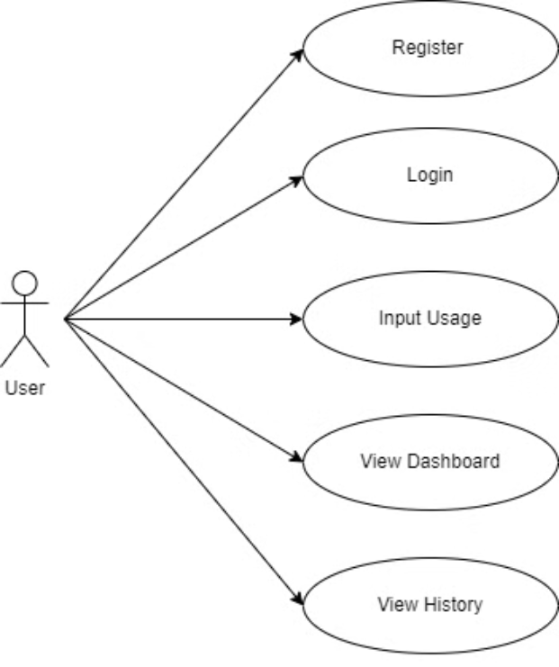
Usecase Diagram

Slide 13
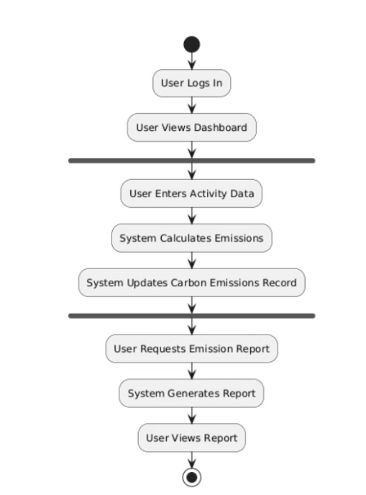
Activity Diagram

Slide 14
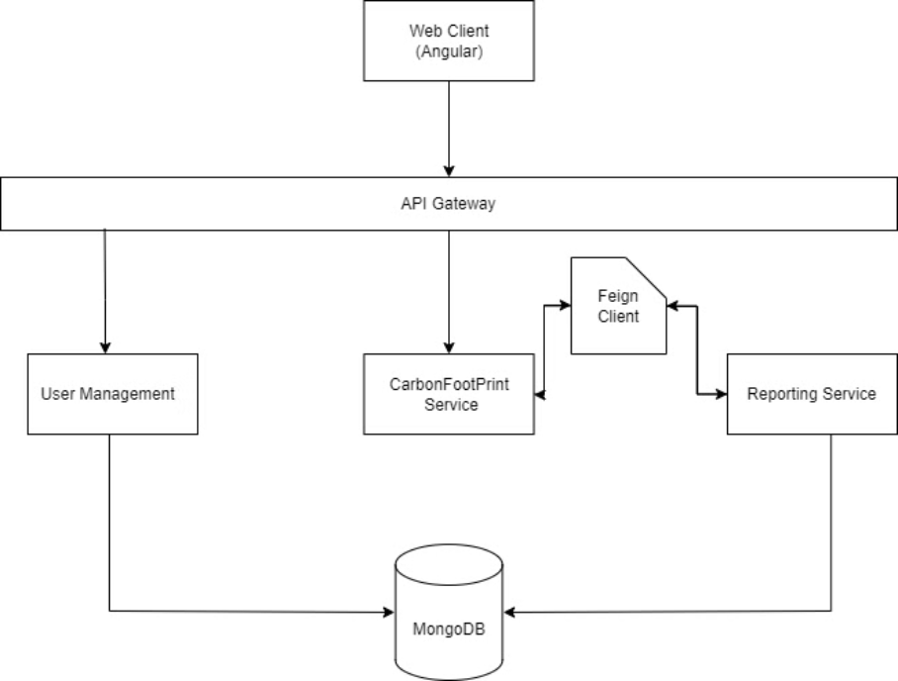
Architecture Diagram

Slide 15
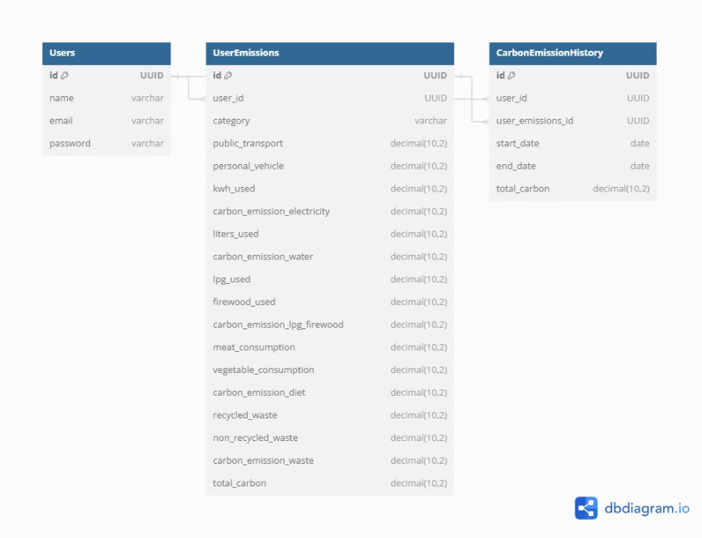
ER Diagram

Slide 16
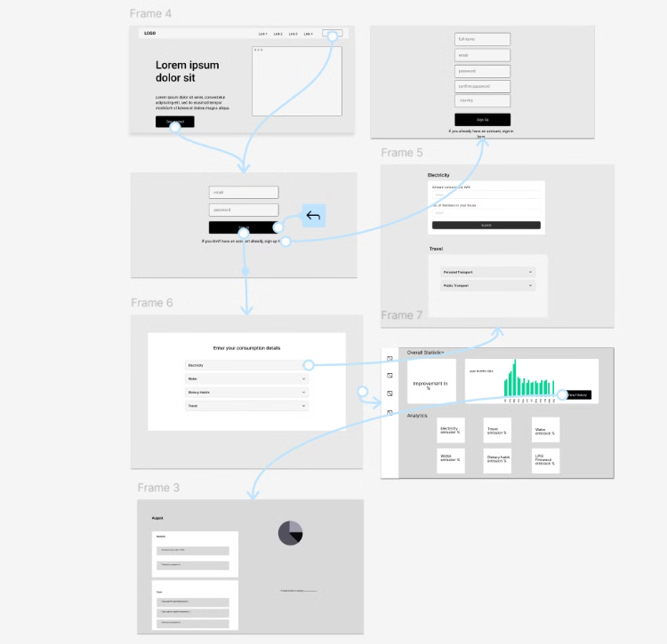
Wireframe Diagram

